Slide 1
UPS Employee Work Environment
By: Dakota Nugget Zach Nikkel

Slide 2
Overview
The system is being proposed because of a need for corporate management to learn about employee discontent without bias from management and human resources. The system is a tool for corporate management to understand their company's operations without bias.

Slide 3
Goals
01
Better Work Environment: The system will allow the corporate management to learn about the conditions the employees are working in and learn what they are most dissatisfied with.
02
Employee Recommendation Rating: The system will allow corporate management to learn what percent of their employees would recommend UPS as an excellent workplace and help them achieve the goal of eighty percent recommendation.

Slide 4
Project objective
Allow the corporate management to learn about the conditions the employees are working in and learn what they are most dissatisfied with. As well as learn what percent of their employees would recommend UPS as an excellent workplace and help them achieve the goal of eighty percent recommendation.

Slide 5
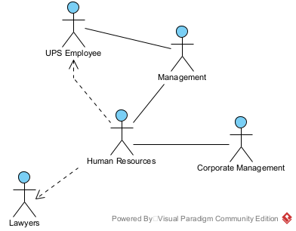
Current System

Slide 6
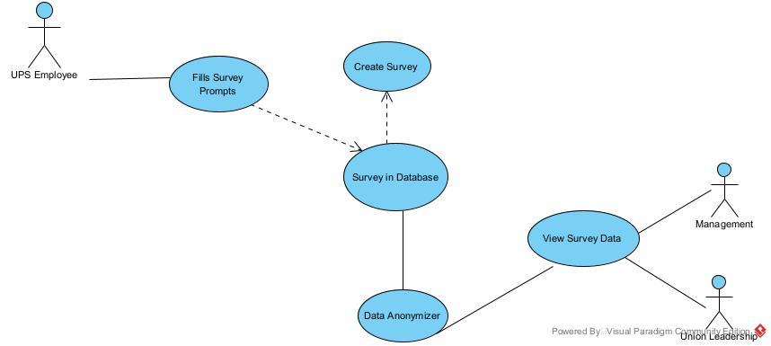
Proposed System

Slide 7
Time and Cost Estimate of Recommended system
Hardware (e.g., servers) | $15,000.00
Software (e.g., e-commerce catalog software) | $20,000.00
Development (e.g., third-party site design and development) | $10,000.00
Total Initial Investments | $45,000.00
Money Saved due to less training costs | $7,500.00
Decreased operation cost due to optimization | $7,500.00
Reduced gas/maintenance costs | $7,500.00
Reduced customer reimbursement costs | $7,500.00
Total Saved | $30,000.00

Slide 8
Time and Cost Estimate of Recommended system
Maintenance | $9,000.00
Project management, customer support | $0.00
Online advertising, search-engine registration (None Issue) | $0.00
Depreciation on capital expenditures (calculation uses five-year period) | $9,000.00
Total Costs | $18,000.00
Net Benefits (Costs) |  | $12,000.00 | $15,000.00 | $18,300.00
Tax |  | $0.00 | $0.00 | $0.00
Value after tax |  | $12,000.00 | $15,000.00 | $18,300.00
Depreciation added back |  | $9,000.00 | $9,000.00 | $9,000.00
Cash flow | -$45,000.00 | $21,000.00 | $24,000.00 | $27,300.00
Total Profit from system | -$45,000.00 | ($24,000.00) | $0.00 | $27,300.00

Slide 9
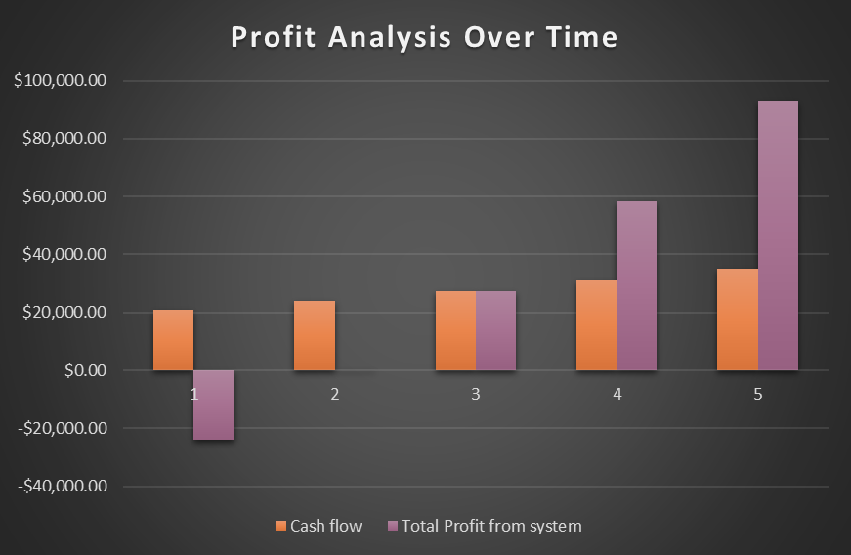
Time and Cost Estimate of Recommended system

Slide 10
Time and Cost Estimate of Alternative System
Hardware (e.g., servers) | $15,000.00
Software (e.g., e-commerce catalog software) | $350.00
Development (e.g., third-party site design and development) | $6,000.00
Total Initial Investments | $21,350.00
Money Saved due to less training costs | $7,500.00
Decreased operation cost due to optimization | $7,500.00
Reduced gas/maintenance costs | $7,500.00
Reduced customer reimbursement costs | $7,500.00
Total Benefits | $30,000.00

Slide 11
Time and Cost Estimate of Alternative System
Maintenance | $10,000.00
Project management, customer support | $0.00
Online advertising, search-engine registration (None Issue) | $0.00
Depreciation on capital expenditures (calculation uses five-year period) | $4,270.00
Total Costs | $14,270.00
Net Benefits (Costs) |  | $15,730.00 | $18,730.00 | $22,030.00
Tax |  | $0.00 | $0.00 | $0.00
Value after tax |  | $15,730.00 | $18,730.00 | $22,030.00
Depreciation added back |  | $4,270.00 | $4,270.00 | $4,270.00
Cash flow | -$21,350.00 | $20,000.00 | $23,000.00 | $26,300.00
Total Profit from system | -$21,350.00 | ($1,350.00) | $21,650.00 | $47,950.00

Slide 12
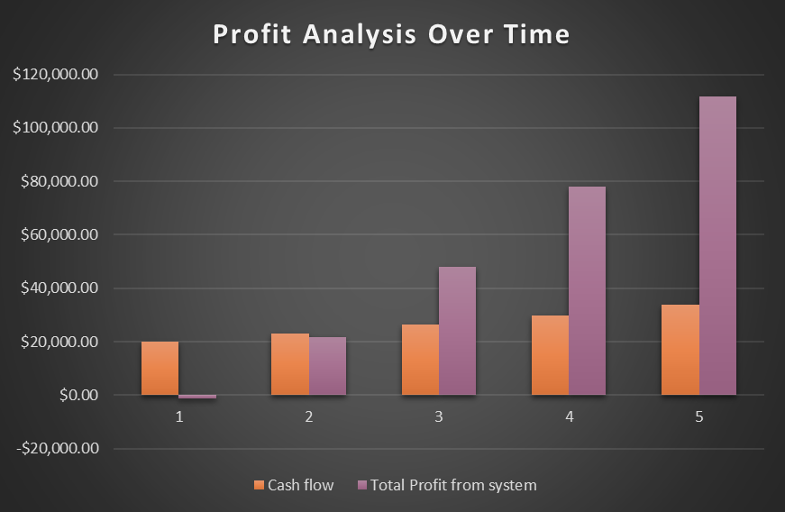
Time and Cost Estimate of Alternative System

